Slide 1
Handwritten number Generation on PYNQ-Z2
Team 9
B07901181 王少群 R11921061 郭霖璟 R10943009 張凱茗
Advisor: Prof. Lai-Jiin
Date: 2022/12/29

Slide 2
Outline
Problem statement
System overview
INT8 Fully-connected model
PYNQ-Z2 result
Conclusion

Slide 3
Outline
Problem statement
System overview
INT8 Fully-connected model
PYNQ-Z2 result
Conclusion

Slide 4
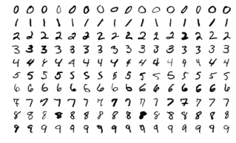
Dataset
MNIST：Handwritten digits dataset
[1] https://en.wikipedia.org/wiki/MNIST_database#/media/File:MnistExamples.png

Slide 5


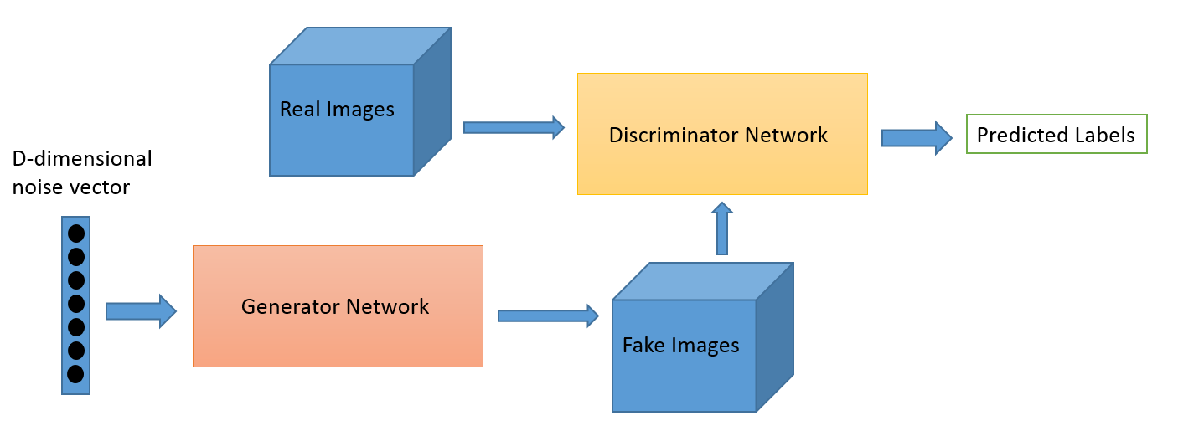






Generative Adversarial Networks
0, 1, 1, 0, ...
26,
44,
57,
97,
105,
12,
55,
...
[2] https://github.com/jonbruner/generative-adversarial-networks/blob/master/notebook-images/GAN_Overall.png

Slide 6
Generative Adversarial Networks
0, 1, 1, 0, ...
26,
44,
57,
97,
105,
12,
55,
...
[2] https://github.com/jonbruner/generative-adversarial-networks/blob/master/notebook-images/GAN_Overall.png

Slide 7
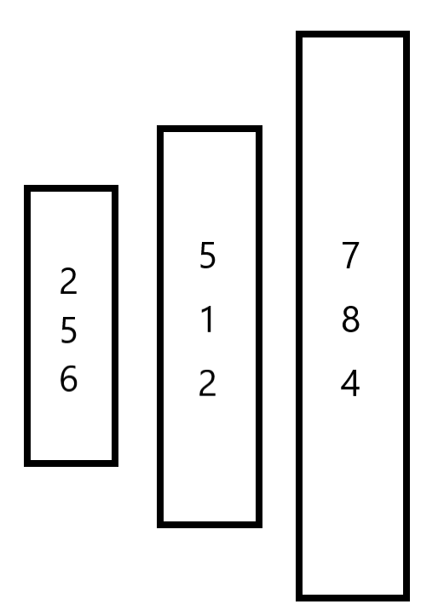
Model Architecture
3-layer fully-connected model
100-dimensional noise vector input
28*28 image output
26,
44,
57,
97,
105,
12,
55,
...

Slide 8
Target
Platform
PYNQ-Z2
Customized model without FINN
Throughput
Running Pytorch model on
CPU：2951.24 FPS
GPU：1333.21 FPS

Slide 9
Outline
Problem statement
System overview
INT8 Fully-connected model
PYNQ-Z2 result
Conclusion

Slide 10
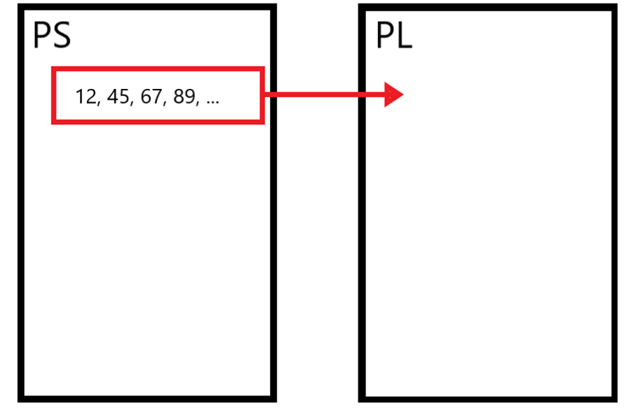
Operation flow

Slide 11
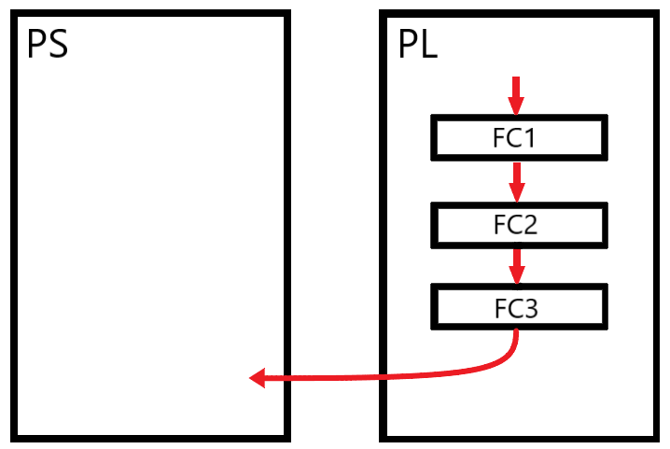
Operation flow

Slide 12
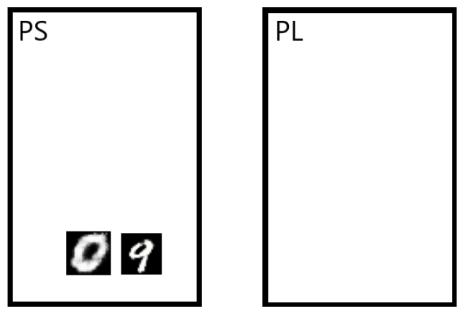
Operation flow

Slide 13
Outline
Problem statement
System overview
INT8 Fully-connected model
PYNQ-Z2 result
Conclusion

Slide 14
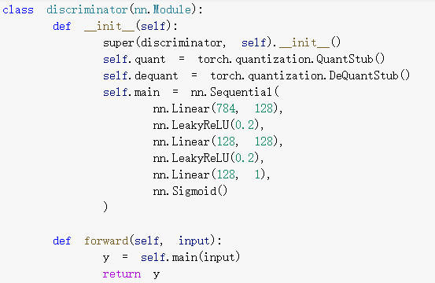
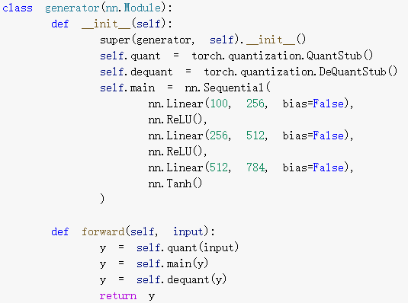
Training model

Slide 15
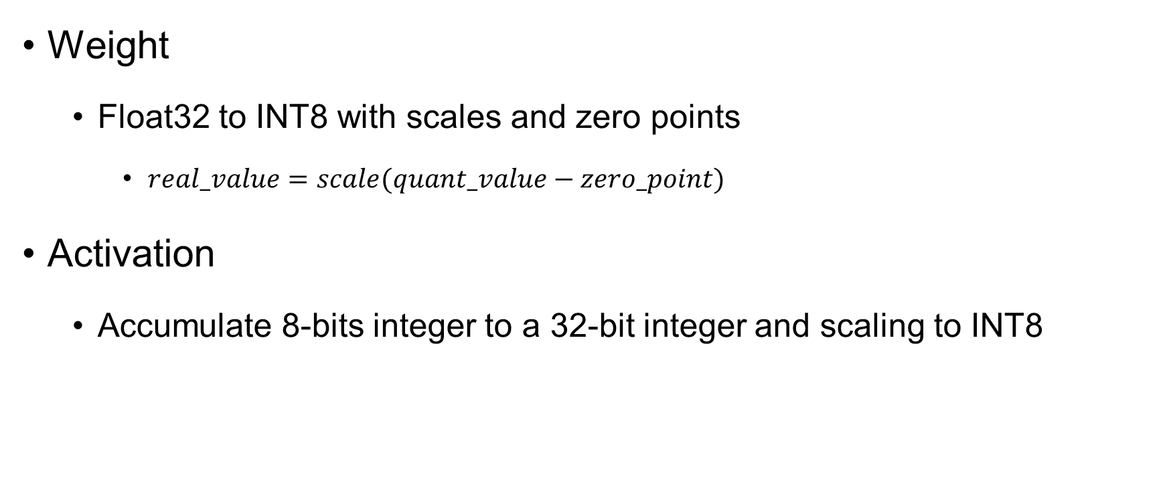
Float32 to INT8
Weight
Float32 to INT8 with scales and zero points
$real_value=scale(quant_value−zero_point)$
Activation
Accumulate 8-bits integer to a 32-bit integer and scaling to INT8

Slide 16
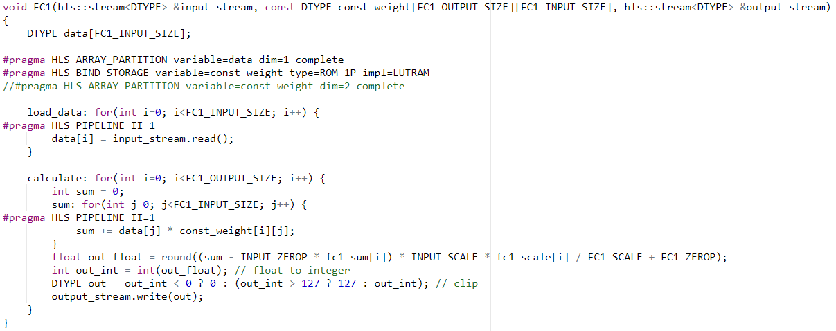
Baseline Architecture

Slide 17
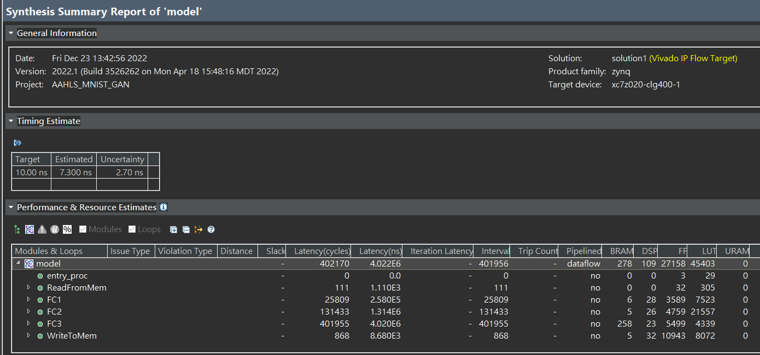
Baseline Architecture

Slide 18
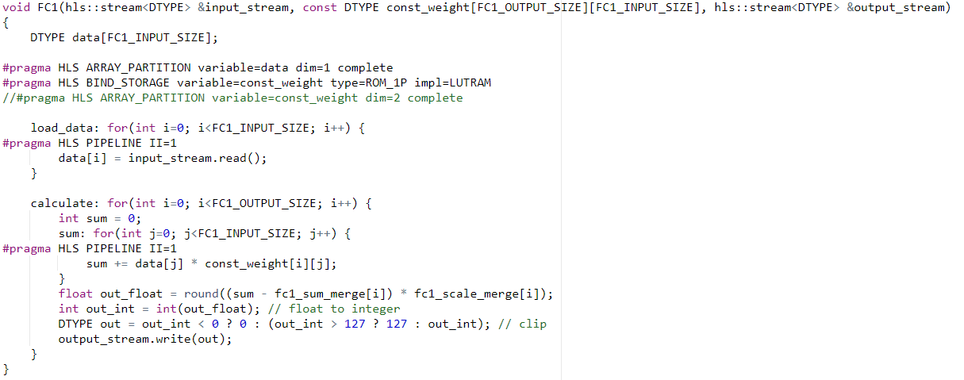
Merge Scaling Factor and HardTanh

Slide 19
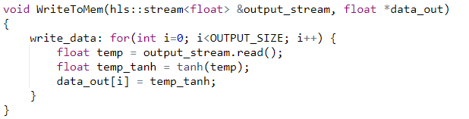
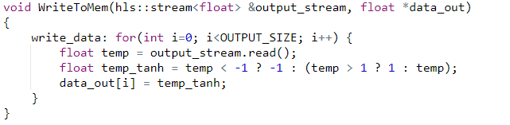
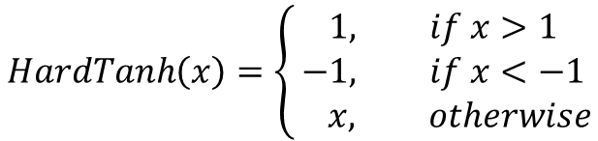

Merge Scaling Factor and HardTanh
$$Tanh\left(x\right)=\frac{e^{2x}−1}{e^{2x}+1}$$
$$HardTanh\left(x\right)=\left\{\begin{aligned}1, if x>1 \\ −1, if x<−1 \\ x, otherwise\end{aligned}\right.$$

Slide 20
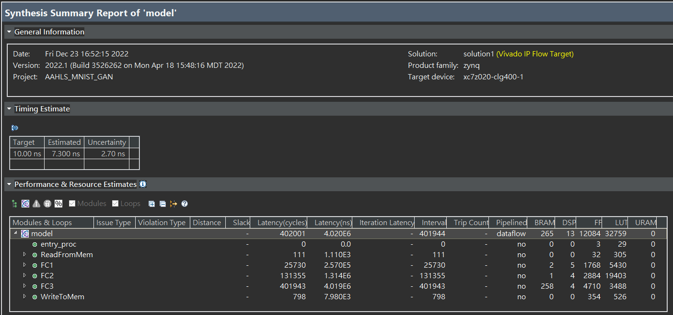
Merge Scaling Factor and HardTanh

Slide 21
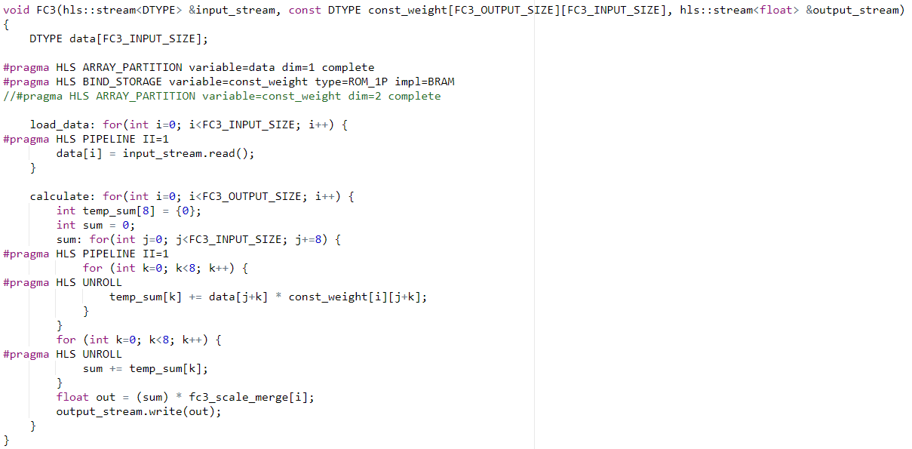
Unroll Bottleneck Layer

Slide 22
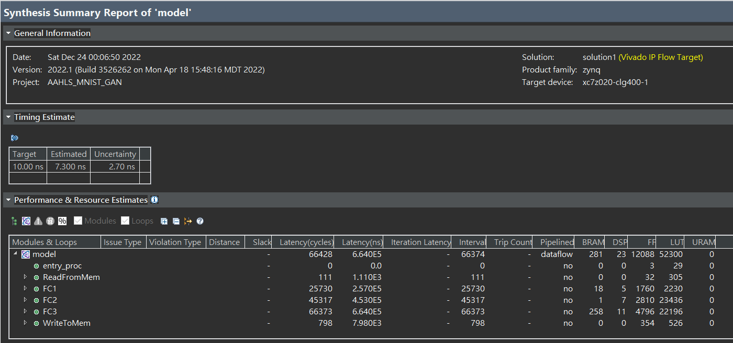
Unroll Bottleneck Layer

Slide 23
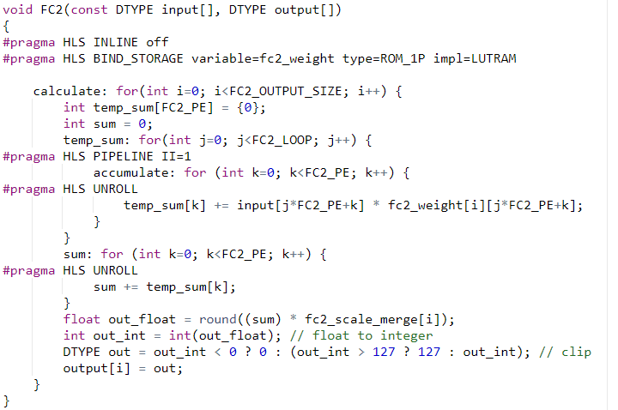
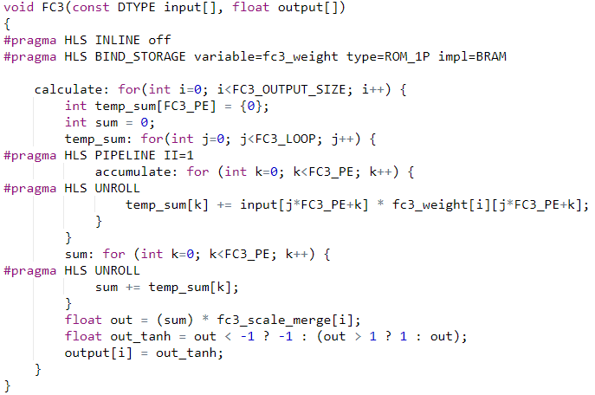
Dataflow Architecture without streaming

Slide 24
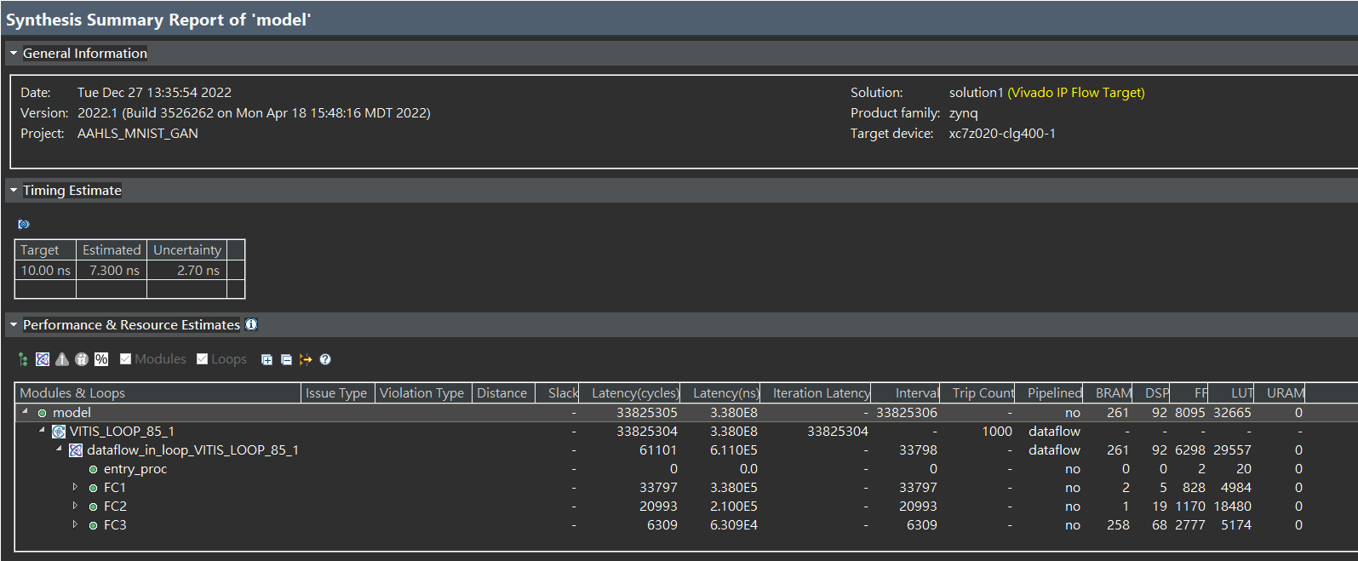
Dataflow Architecture without streaming

Slide 25
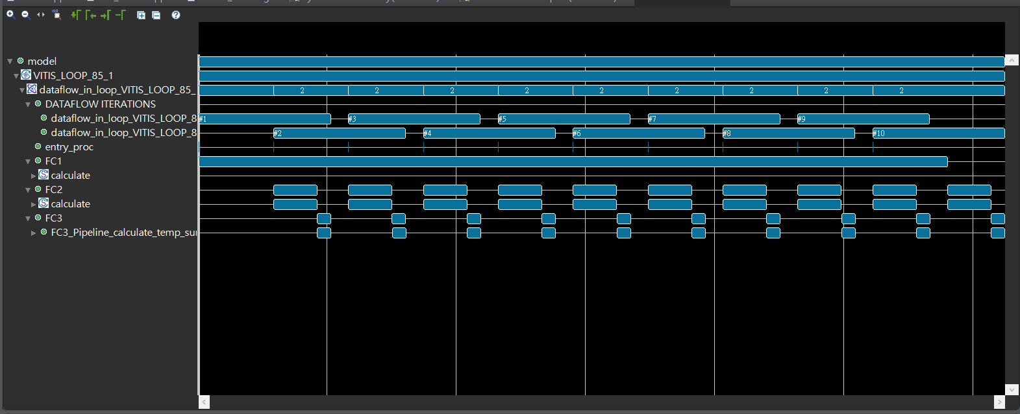
Dataflow Architecture without streaming

Slide 26
Outline
Problem statement
System overview
INT8 Fully-connected model
PYNQ-Z2 result
Conclusion

Slide 27
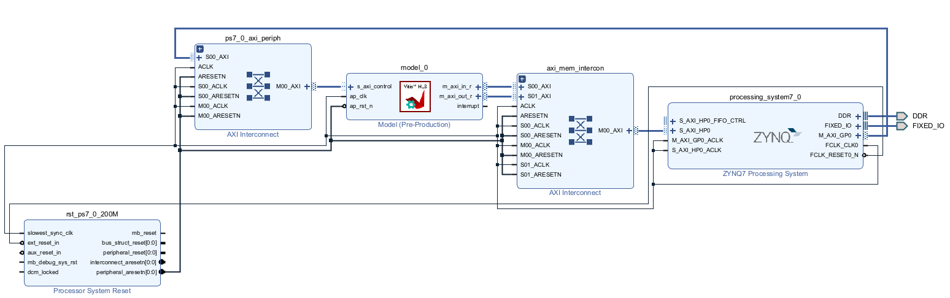
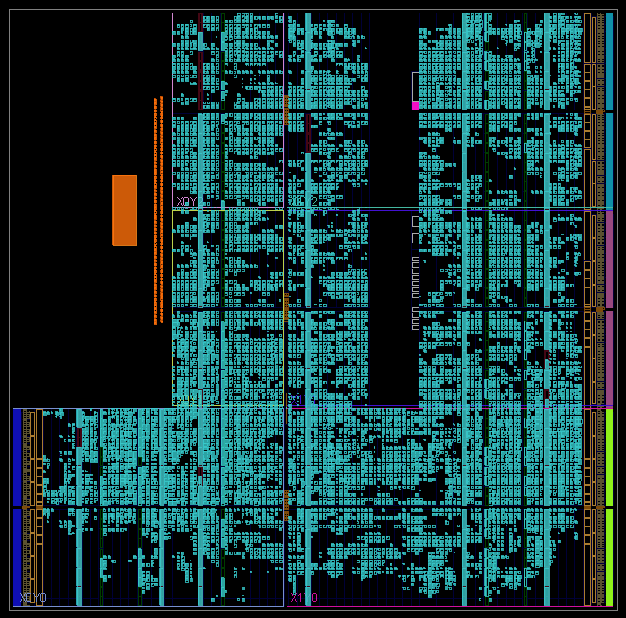
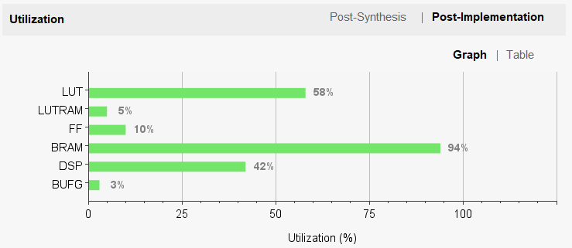
Result

Slide 28
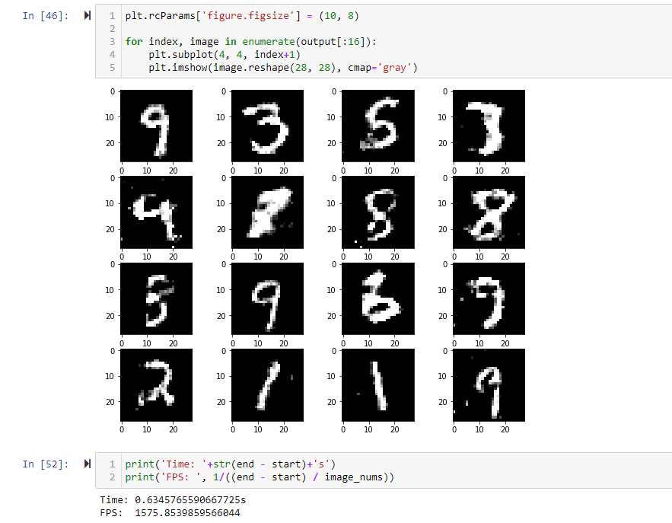
Result

Slide 29
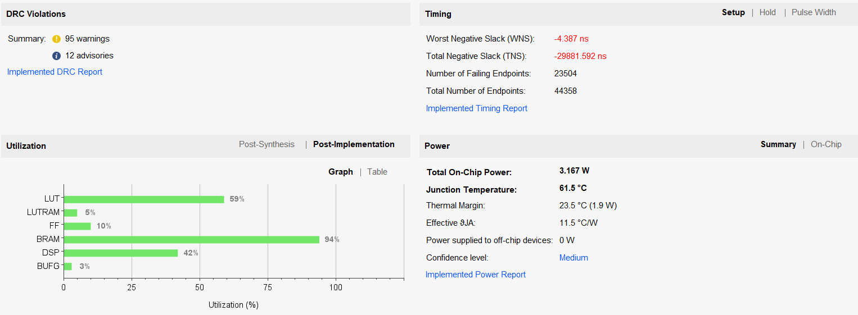
Result
Change ZYNQ7 Processing System PL Clock to 200 MHz

Slide 30
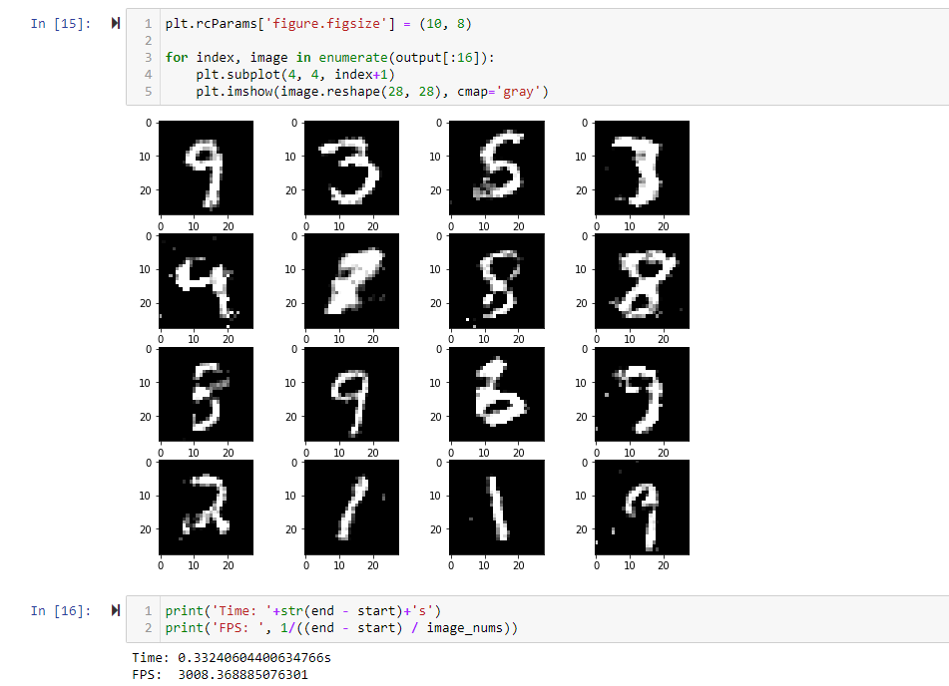
Result
Throughput：3008.36 FPS
CPU：2951.24 FPS
GPU：1333.21 FPS

Slide 31
Outline
Problem statement
System overview
INT8 Fully-connected model
PYNQ-Z2 result
Conclusion

Slide 32
Conclusion
Learning to build a Neural Network model accelerator on FPGA without FINN.
Using streaming interface between multiple kernels.
Future work
Implement more Neural Network architecture, like convolution.
Lower-bit weight and activation accelerator.

Slide 33
Reference
[1] https://en.wikipedia.org/wiki/MNIST_database#/media/File:MnistExamples.png
[2] https://github.com/jonbruner/generative-adversarial-networks/blob/master/notebook-images/GAN_Overall.png

